Slide 1
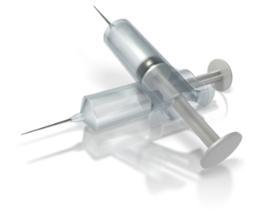
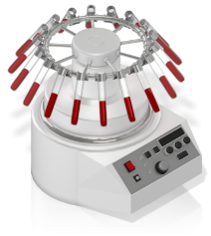
Kev txhaj tshuaj tiv thaiv kab mob siab B rau koj tus me nyuam
Txhaj 1 - me nyuam mos yuav tau txhaj koob tshuaj no thaum nyuam qhuav yug los
koob thij # 3– tsawg kawg yog 6 lub hlis tom qab txhaj tshuaj tas 2.
Ntsuam xyuas kev HBsAg kuaj los ntawm koj tus kws kho mob yog koj cev tsis tab seeb
Yog hais tias koj muaj kab mob siab B lawm, hais kom tus kws kho mob kuaj koj tus me nyuam cov ntshav kom thiaj paub meej tias qhov tshuaj tiv thaiv puas tau hauj lwm.
Koob thij # 2 - tsawg ib lub hlis (los yog hnub 28) tom qab txhaj tas koob tshuaj thib
KOJ PUAS PAUB
Tshuaj tiv thaiv kab mob siab B yog ib yam tshuaj tiv thaiv uas tsis txaus ntshai thiab ua hauj lwm zoo tshaj plaws.
Yog koj muaj tus kab mob siab b, koj tus me nyuam yug los yuav tsum tau txhaj tus tshauj hu ua Hepatitis B Immune Globulin (HBIG) thaum tseem nyob hauv lub hoob yug me nyaum.
Yog tsis nrhiav kev pab thiab txhaj tshuaj ces tshaj 90% ntawm cov me nyuam mos yug los ntawm niam uas muaj Kab Mob Siab B yuav muaj Kab Mob Siab B Chronic"

