Slide 1
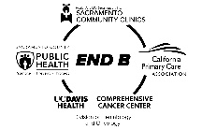

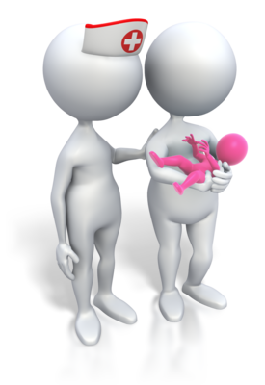
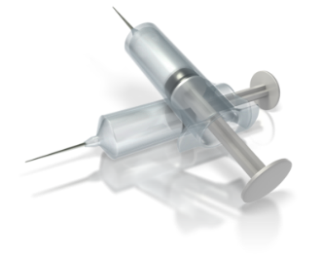
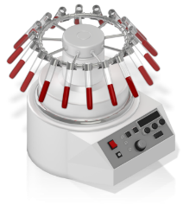

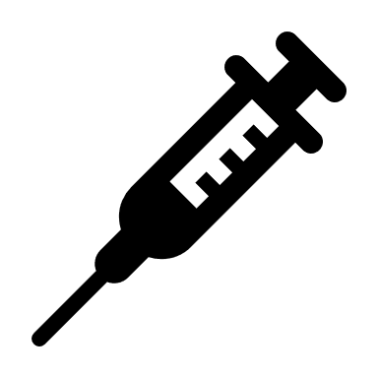
BE PROACTIVE IN YOUR CHILD’S HEALTH
Vaccination prevents Hepatitis B!
1st Shot - Newborns should receive this dose in the delivery room.
3rd Shot – At least 6 months old after 2nd shot.
If you are hepatitis B positive, ask for a simple blood test for your child. This confirms whether the vaccination was successful for the child.
Get a HBsAg screen test by your doctor if you are pregnant.
2nd Shot - At least one month (or 28 days) after the 1st shot.
DID YOU KNOW?
Hepatitis B vaccine is considered one of the safest and most effective vaccines ever made.
If you test positive for hepatitis B, your newborn must be given a medication called Hepatitis B Immune Globulin (HBIG) in the delivery room.
Babies born to a mother with hepatitis B have a greater than 90% chance of developing chronic hepatitis B if they are not properly treated at birth.
Notes:
Add STEPS on what to do and what to expect for vaccination and having your child to take the shots.

