Slide 1
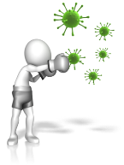
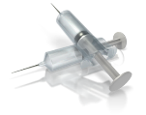
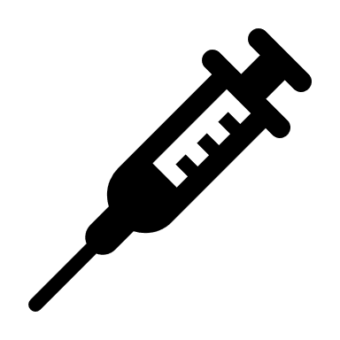
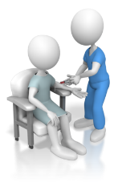
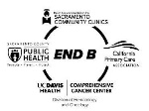
BE PROACTIVE ON HEPATITIS B
What can you do?
DID YOU KNOW
STEP #3
Get your family and people you know SCREENED and VACCINATED
Pregnant women can prevent their newborn from getting Hepatitis B
STEP #4
Keep you and your family healthy
STEP #2
Hepatitis B is 50 to 100 times more infectious than HIV
If you are negative
GO get vaccinated.
STEP #1
Get blood screen for Hepatitis B
Vaccination is a safe and the most effective way to prevent Hepatitis B infection
The vaccine is 95% effective in preventing chronic Hepatitis B.
Notes:
The journey through Hepatitis B

